Slide 1
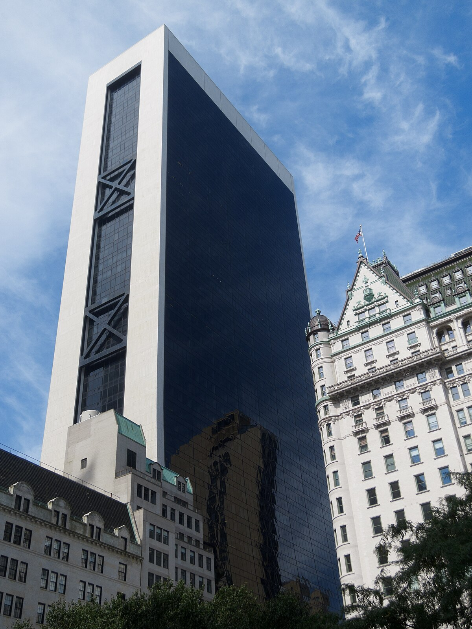



Topics in Portfolio Management
Paolo Rinaldi
Financial Analysis

Slide 2

History
Launches origination platform
Apollo and Athene merge
Offices in Singapore and London
Enters energy infrstructure business
Athene is founded
2022
2006
2013
2009
2008
2016
2018
2021
2024
2011
Athene is listed on NYSE
1990
GFC: a great opportunity
Establishes capital solutions business
$ 751b AUM
Foundation
Apollo is listed on NYSE

Slide 3
Historical stock price

Slide 4




Business overview
Asset Management
Retirement
solutions
Financial
services
Credit
Equity
Real Assets
Capital solutions
Key driver: the ability to originate assets that offer alpha

Slide 5








Strategy
A unique integrated platform
WHAT
THEY DO
Private credit expansion
Credit origination
High-grade
lending
Capital
solutions
Private
equity
HOW
THEY DO IT
Apollo – Athene
synergy
Flexibility and
bespoke solutions
Reduced timings
and global presence

Slide 6




Market opportunities
$ 150T+
Individuals
$ 75T+
Global industrial renaissance
$ 45T+
Retirement
$ 50T+
Re-thinking Public vs Private

Slide 7
General statistics

Slide 8
Beta

Slide 9
Historical Beta

Slide 10
Technical analysis
Moving averages

Slide 11
Technical analysis
Moving averages

Slide 12
Technical analysis
Bollinger bands

Slide 13
Technical analysis
Momentum by ROC

Slide 14
Technical analysis
RSI oscillator

Slide 15
Technical analysis
MACD

Slide 16
Eps forecasts

Slide 17
Eps forecasts using Holt’s Method
MSE Method 1 | MSE Method 2
/ | /
0,047 | 0,047

Slide 18
Residual income
Input data
Persistence Factor | 0,55
Ke LT | 9,0%
Growth LT | 4,0%
Coef Ar | 55,0%
Roe long time | 15,0%
Total value | $ 121,11
PV RI Cumlated | 17,89%
PV Terminal Value | 53,20%
BV (2022) | 28,92%
Total Value | $ 121,11
Stock price at 31/12/2024 | $ 165,16
Upside/(downside): | -27%

Slide 19
WACC
WACC CALCULATION | 2024
RF rate (US 10y) | 4,50%
Beta | 1,43
Eq Risk Premium | 5,00%
E(r) on mkt | 9,50%
Re | 11,67%
Tax Rate | 30%
Debt / Equity | 15,43%
(Debt) / (Debt + Equity) | 13,37%
Rd | 4,98%
WACC | 10,58%
Disc factor | 0,904
Interest coverage | 2,38
Rating Estimated | BB+
Default Spread Estimated | 4,50%
Rd Estimated | 9,00%

Slide 20
AUM growth
Year | AUM ($b) | yoy %
2008 | 40,00 | /
2009 | 50,00 | 20%
2010 | 67,55 | 26%
2011 | 75,22 | 10%
2012 | 113,38 | 34%
2013 | 161,18 | 30%
2014 | 159,80 | -1%
2015 | 170,12 | 6%
2016 | 191,69 | 11%
2017 | 248,90 | 23%
2018 | 280,26 | 11%
2019 | 331,00 | 15%
2020 | 455,49 | 27%
2021 | 497,55 | 8%
2022 | 547,65 | 9%
2023 | 650,78 | 16%
2024 | 751,04 | 13%
2025 | 881,93 | 15%
2026 | 1014,96 | 13%

Slide 21
DCF based on FRE ps and PF ps
Date | FCFF ps | AUM ($B) | Mkt cap | Price ps | #n of shares (M) | FRE ps | Performance Fee ps | Normalized FCFF ps
31/03/2012 | -2,282 | 110 | 1803,70 | 14,28 | 126,310 | 0,22 | -2,502 | -2,282
29/06/2012 | 1,782 | 110 | 1568,11 | 12,40 | 126,461 | 0,22 | 1,562 | 1,782
28/09/2012 | 3,935 | 110 | 1903,96 | 14,66 | 129,874 | 0,22 | 3,715 | 3,935
31/12/2012 | -1,523 | 110 | 2257,22 | 17,36 | 130,024 | 0,22 | -1,743 | -1,523
31/03/2021 | -1,019 | 461,1 | 10904,72 | 47,01 | 231,966 | 0,92 | -1,941 | -1,019
30/06/2021 | 5,688 | 471,8 | 14450,26 | 62,20 | 232,319 | 0,94 | 4,744 | 5,688
30/09/2021 | 4,307 | 481,1 | 14506,13 | 61,59 | 235,527 | 0,96 | 3,345 | 4,307
31/12/2021 | -4,512 | 497,55 | 18010,17 | 72,43 | 248,656 | 1,00 | -5,507 | -4,512
31/03/2022 | -6,814 | 512,84 | 37194,00 | 61,99 | 600,000 | 1,03 | -7,840 | -6,814
30/06/2022 | 6,792 | 514,76 | 27849,75 | 48,48 | 574,459 | 1,03 | 5,762 | 6,792
30/09/2022 | 4,014 | 523,29 | 26620,18 | 46,50 | 572,477 | 1,05 | 2,967 | 4,014
30/12/2022 | 2,513 | 547,65 | 36505,97 | 63,79 | 572,284 | 1,10 | 1,418 | 2,513

Slide 22
DCF based on FRE ps and PF ps
Year | 2024 | 2025 | 2026 | 2027 | 2028
FCFF ps | 8,72 | 8,676 | 11,854 | 11,541 | 10,553
Growth |  | -0,54% | 36,62% | -2,64% | -8,56%
Ke CALCULATION
RF rate (US 10 Yr ) | 4,50% | 4,50% | 4,50% | 4,50% | 4,50%
Beta APO | 1,43 | 1,43 | 1,43 | 1,43 | 1,43
Mkt risk premium | 5,00% | 5,00% | 5,00% | 5,00% | 5,00%
Cost of Equity | 11,67% | 11,67% | 11,67% | 11,67% | 11,67%
Cost of Debt | 4,98% | 4,98% | 4,98% | 4,98% | 4,98%
D/E | 15% | 15% | 15% | 15% | 15%
WACC | 10,58% | 10,58% | 10,58% | 10,58% | 10,58%
Discount Factor |  | 90,43% | 81,78% | 73,96% | 66,88%
DCF EVALUATION
Discounted FCFF ps | 8,72 | 7,85 | 9,69 | 8,54 | 7,06
Cum discounted FCFF ps | 8,72 | 16,57 | 26,26 | 34,80 | 41,86
Long Term Growth Rate | 4,00%
Long Term WACC | 10,58%
VALUATION
Cumulated FCFF ps | $ 48,56
Discounted Terminal Value ps | $ 94,01
Terminal Value ps | $ 140,56
Debt Value ps | $ -0,42
Equity Value | $ 142,99
EV ps | $ 142,57
31/12/24 Stock Price | $ 165,16
Upside/(downside) | -13,68%

Slide 23
DCF Montecarlo
 | 2024 | 2025 | 2026 | 2027 | 2028
FCFF ps | 8,72 | 8,68 | 11,85 | 11,54 | 10,55
std dev | 1,792 | 1,784 | 2,435 | 2,372 | 2,168
reference | 8,970 | 10,611 | 5,572 | 9,484 | 7,924
From historical data (last 5 years) in order to reflect the enormous volatility of FCFF ps for APO
21%
Max | $ 201,42
Min | $ 71,55
Mean | $ 136,72
Std dev | 21,50
Rating | Price | Sample | Parameter | Probability
Buy | $ 189,93 | 4 | 15% | 0,4%
Hold | $ 176,72 | 427 | 7% | 42,7%
Sell | $ 140,39 | 569 | -15% | 56,9%

Slide 24
Multiples analysis: P/E
 | 2021 | 2022 | 2023 | 2024 | F12m | T12m
Eps TTM | 4,56 | 5,21 | 6,74 | 7,39 | 8,35 | 6,74
Price 31/12 | 72,43 | 63,79 | 93,19 | 165,16 | 165,16 | 165,16
 | 2021 | 2022 | 2023 | 2024 | F12m | T12m
P/E | 15,88 | 12,24 | 13,83 | 22,35 | 19,79 | 24,50
 | 2021 | 2022 | 2023 | 2024 | F12m | T12m
E/P | 6,30% | 8,17% | 7,23% | 4,47% | 5,05% | 4,08%

Slide 25
Multiples analysis vs Peers
Ticker Symbol | Company Name | P/E | Div Yield | P/CF | P/Sales | EV/Sales | EV/EBITDA
APO | Apollo Global Management | 22,35 | 1,10% | 18,93 | 3,56 | 2,32 | 12,14
KKR | KKR & Co. | 31,07 | 0,47% | 15,43 | 4,40 | 7,46 | 26,98
BX | Blackstone Inc. | 37,16 | 2,02% | 29,55 | 15,92 | 21,04 | 32,39
BLK | BlackRock | 23,53 | 1,99% | 43,87 | 7,78 | 1,23 | 18,74
GS | Goldman Sachs | 14,12 | 2,01% | -1,88 | 1,48 | 1,33 | 5,51
MS | Morgan Stanley | 15,83 | 2,82% | -6,38 | 1,89 | 5,40 | 5,27
SCHW | Charles Schwab | 22,77 | 1,35% | 7,58 | 5,21 | 9,75 | 8,92

Slide 26
Multiples analysis vs strict Peers
Ticker Symbol | Company Name | FRE 2023 | FRE 2024 | yoy % | AUM 2023 | AUM 2024 | yoy %
APO | Apollo Global Management | 1,80 | 2,10 | 14,29% | 650,776 | 751,037 | 13,35%
KKR | KKR & Co. | 2,38 | 3,27 | 27,05% | 552,801 | 637,572 | 13,30%
BX | Blackstone Inc. | 4,30 | 5,30 | 18,87% | 1040,192 | 1127,18 | 7,72%
Ticker Symbol | Company Name | % FRE conv | P/FRE | P/AUM
APO | Apollo Global Management | 0,28% | 78,65 | 0,22
KKR | KKR & Co. | 0,51% | 45,26 | 0,23
BX | Blackstone Inc. | 0,29% | 52,76 | 0,15

Slide 27
Black-Litterman Portfolio
 | ABV | PGR | GILD | TMUS | BSX | UBER | CME | WMB | VST | APO
Portfolio | 15,99% | 10,01% | 7,42% | 19,23% | 9,89% | 10,38% | 5,69% | 6,34% | 6,93% | 8,12%
Market cap | 314020,84 | 140366,29 | 115117,58 | 256154,22 | 131642,27 | 127016,39 | 83686,91 | 65972,92 | 46906,99 | 93450,25
Value weighted | 22,85% | 10,21% | 8,38% | 18,64% | 9,58% | 9,24% | 6,09% | 4,80% | 3,41% | 6,80%
Deviation | 25,12%

Slide 28
Final evaluation
Technical analysis
Moving averages | SELL
Bollinger bands | SELL
Momentum | SELL
RSI | HOLD
MACD | SELL
Models
Residual income | SELL
DCF | SELL
Final advice:
SELL

Slide 29
Thank you

